Slide 1

TMI Engineering
Company Profile

Slide 2
Index
About
Services Leadership Capabilities
Contact us

Slide 3

About Us

Slide 4

TMI Engineering is established with an objective to provide safe & mechanised solutions for Mining, Tunnelling and Infrastructure sectors.
We are committed to create a long-term value for our customers by empowering them with most advance and future-ready Technologies to maximize their productivity and making their business competitive.
Through innovation and excellence, we strive for a sustainable future – one that encompasses
Human Resource
Technology
Technology Utilization & Optimization
Enhance Longevity of Investment
Strong Business Ethics
Relationship.
We would like to focus on complete ecosystem and can take end to end responsibility for our customer’s Automation, Digitization and Equipment maintenance needs.
Our Core VALUES are Ethics, Responsive, Passion, Speed & Respect

Slide 5

Our Portfolio

Slide 6
TMI Engineering Product Portfolio
Tunneling
Shotcrete from TunelMak
Mining
Shotcrete Machines, Concrete Transport Equipment, Personnel Carrier Equipment, Explosive Charging, Scissor Lifts , Utility vehicles like PC, Maint vehicle from TunelMak
Infrastructure
Concrete Batching Plant from Eurotech
Safety Chambers from Aysan
Drilling Jumbo from Huatai
LHD Range 20-45 Tonnes Capacity, LPDT Range 15 Tonnes from King Ant
Drilling Jumbo, Scaler, DTH, Bolting Jumbo from Huatai
Small utility support Machines from Kovatera
Refuge Chambers from Aysan
Concrete crushers from Proman
Asphalt Batching Plant from Linhoff

Slide 7


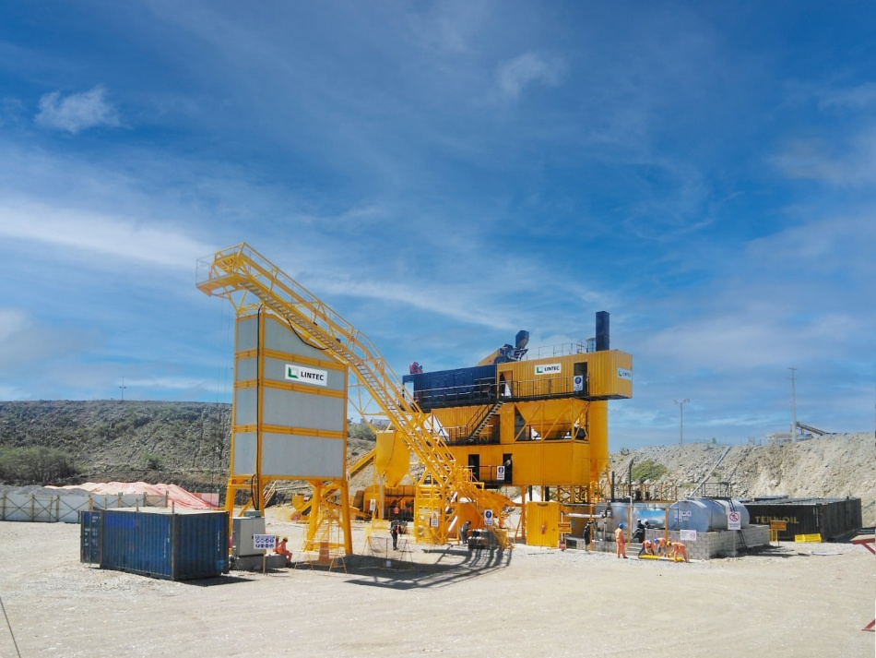
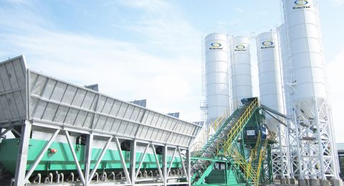
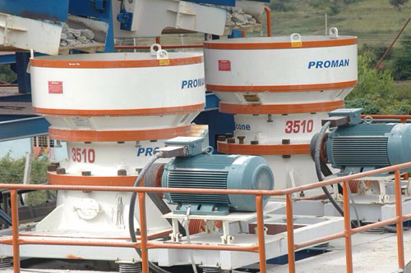
North India Partner -Gainwell
Gainwell is manufacturing/marketing equipment's of following brands for Indian Market.
a) Linnhoff Asphalt Batch Mix Plant from 120 to 200 TPH and Hot/Cold Recycled Asphalt Batch Mix Plants
b) Eurotech Concrete Batch Mix Plants with 60 CUM & above capacity and also Special application Concrete Batching Plants - Dam Series & Precast Mix Series
c) PROMAN make series of Crushers for Primary, Secondary and Tertiary Crushing applications with a capacity range varying from 80-450 TPH and can take feed size of up to 320 mm.
There are Large number of plants which are serving leading Infrastructure Construction Companies across India besides having a very strong Global Presence.

Slide 8

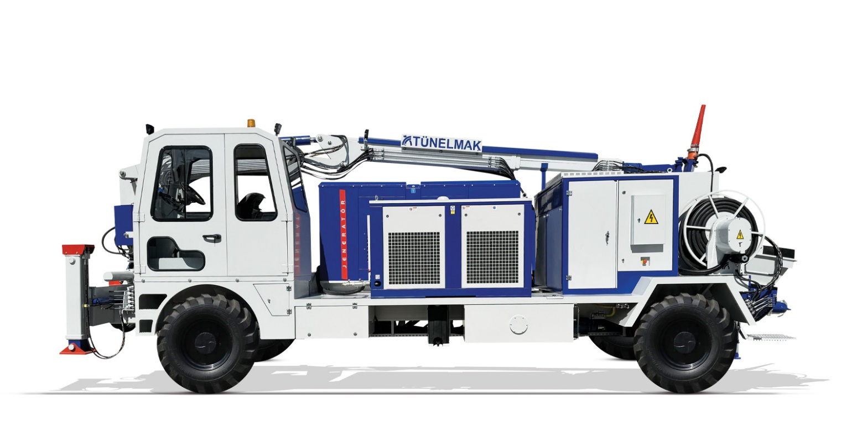
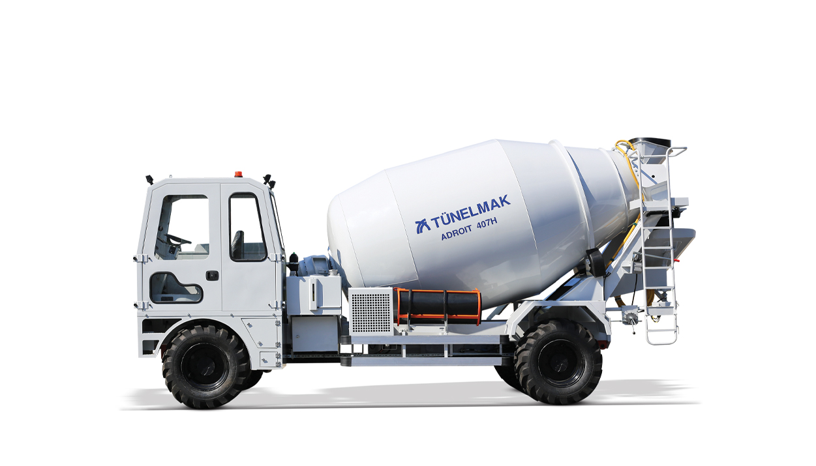
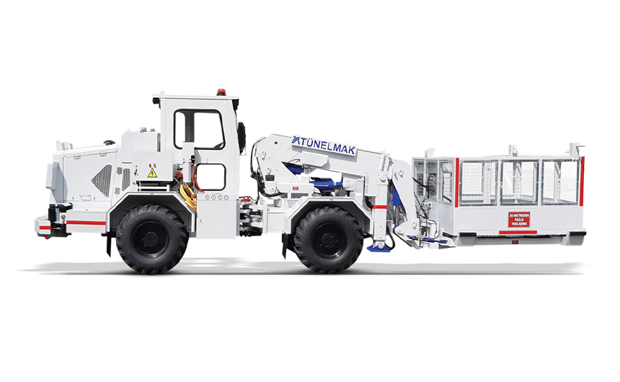
India Partner -Tunelmak
Tunelmak is a Turkey based engineering company, leading the market in Middle East, Euro-Asia & Russia in Tunnelling and Underground Mining Service equipment domain. Tunelmak is popular for Shotcrete solutions (6 Cum to 30 Cum with 3Mts to 15 Mts Height) , Explosive Charging, UG Utility Installation , Man & Material Movement Equipment for UG Mines

Slide 9

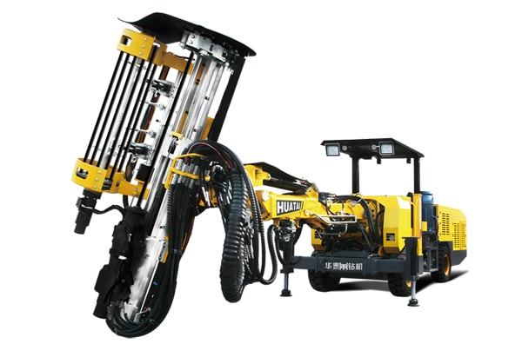
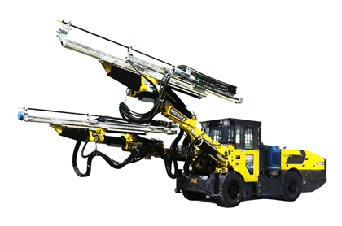
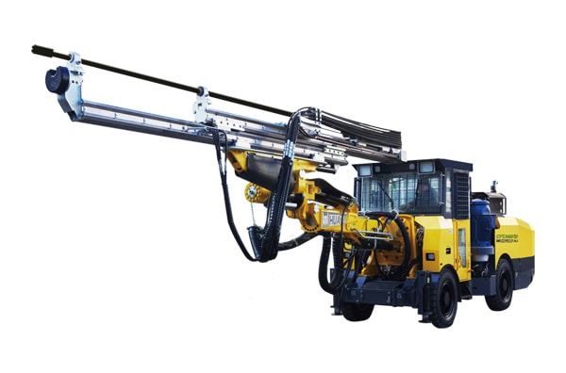
India Partner- Huatai
Huatai is a China based company having their business in Jumbo Drill for Tunnelling and Mining space. They have presence in China, Russia and Asia with the distinction of having supplied over 1600 units since its inception in year 2000. They offer Hydraulic Drilling Jumbo for tunnelling and Mining, Down –The-Hole (DTH) Drilling Rigs, Hydraulic Bolting Jumbo, Mining and Tunnelling Scalers.

Slide 10

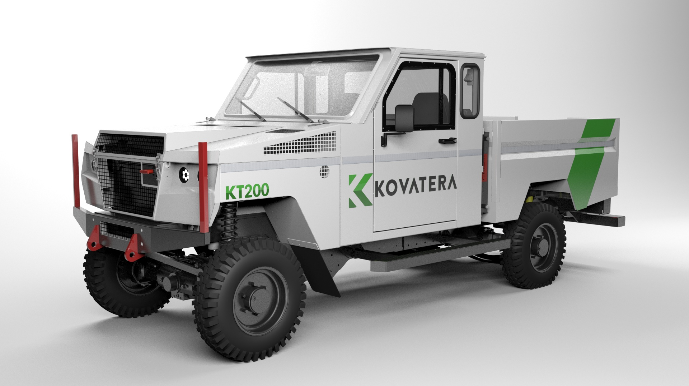
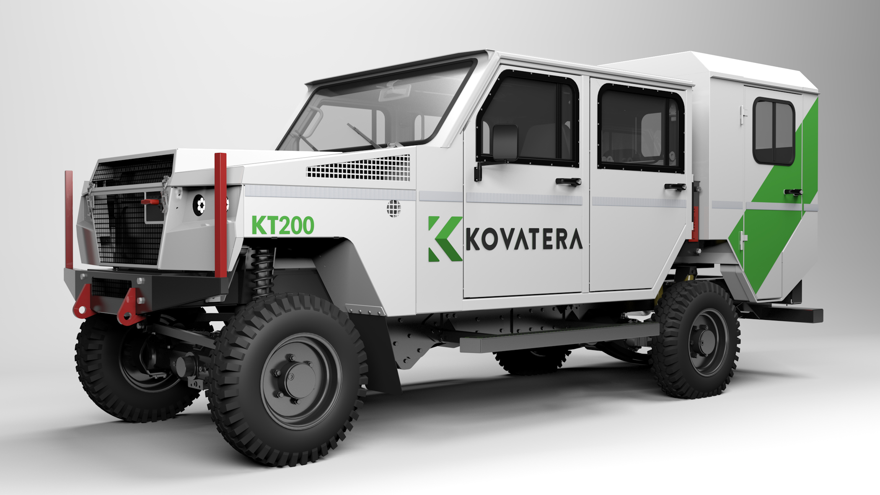
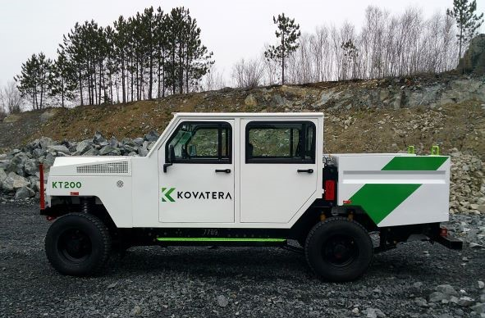
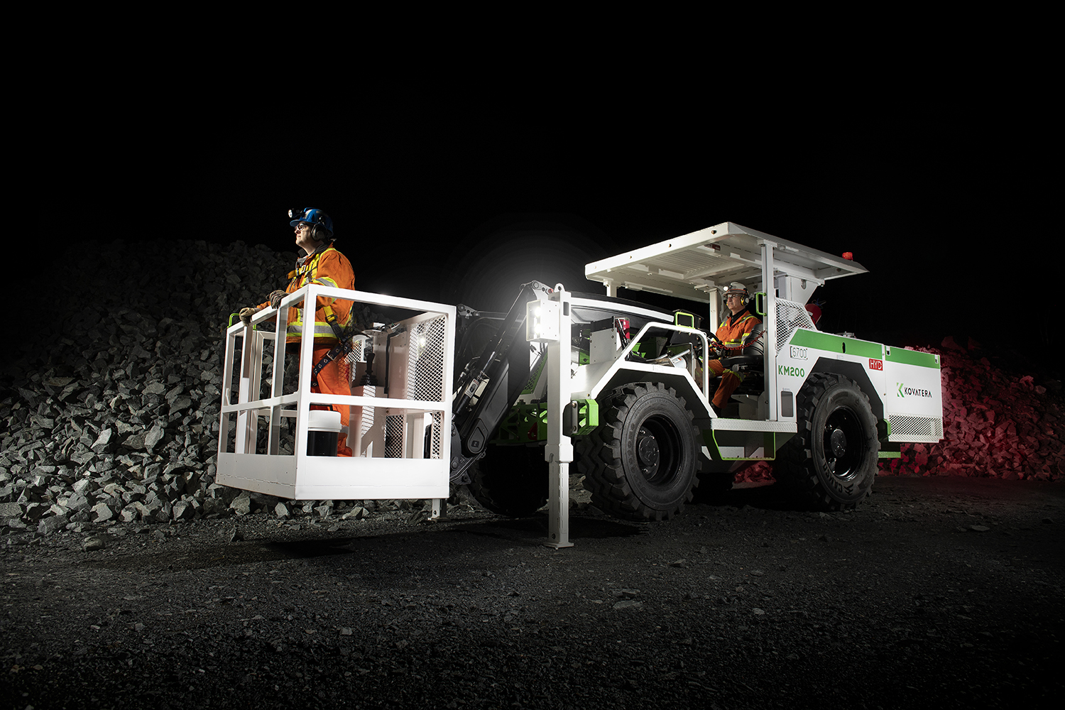
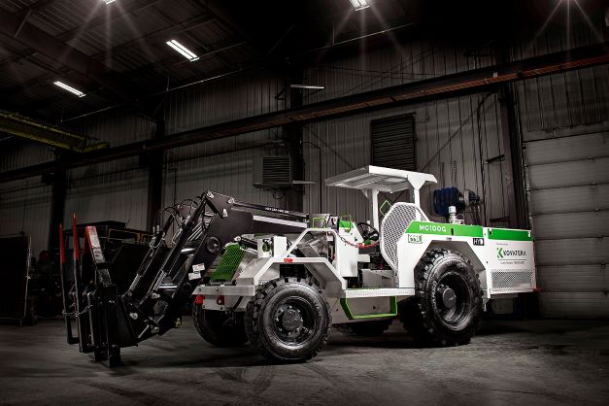
Exclusive India Partner -Kovatera
Kovatera is a Canada based company manufacturing purpose engineered underground mining utility vehicles. Kovatera takes pride in serving leading Miners with state of the art Purpose built machines in North & South America, Europe and Indonesia with a strong population of over 1300 units working

Slide 11
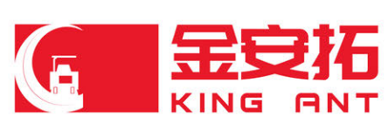
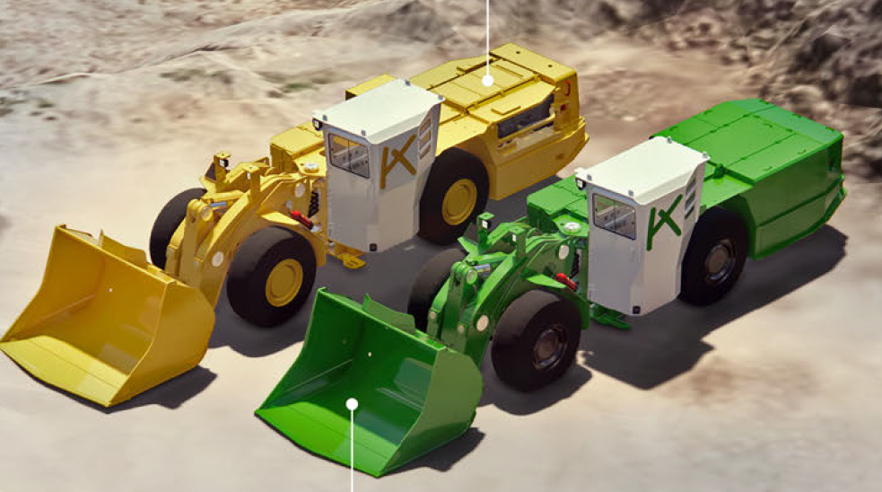
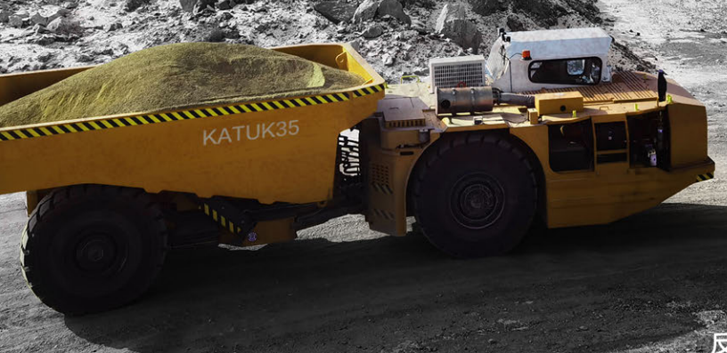
India Partner -JCHX
JCHX is big Mining company in China. They are manufacturing the Loaders and Dumpers for underground mining with brand name King Ant. Their Products include LHD Range 20-45 Tonnes Capacity and LPDT Range 15 Tonnes

Slide 12
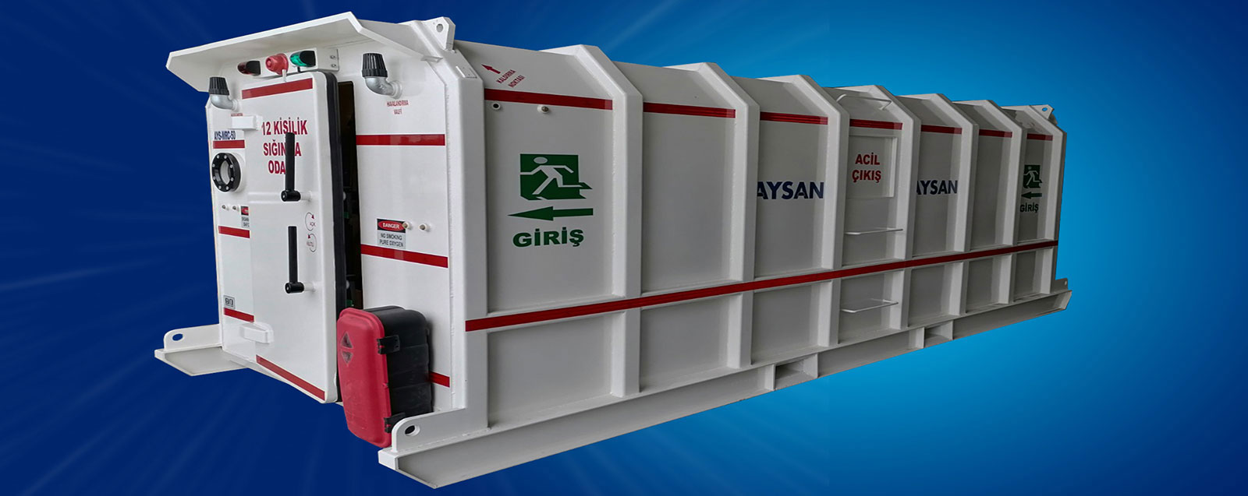
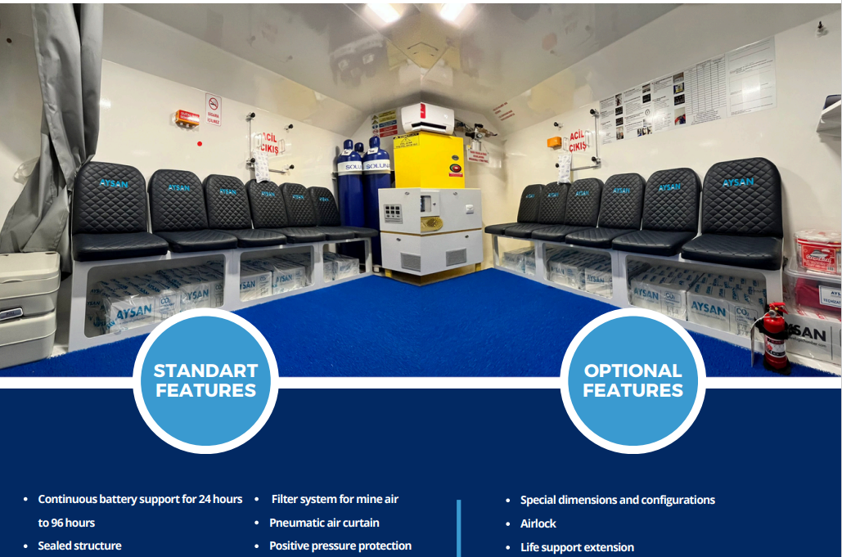
Exclusive India Partner –AYSAN
TMI is an exclusive Channel partner for underground permanent, mobile and skid mounted Aysan Refuge chambers in India
AYSAN Refuge Chambers are specially designed for
  Underground Metal mines
  Underground Coal mines
  Tunnel Projects
  Open Cast Mines
  Protection from Gases/ Loose Falls/Explosions
  Can accommodate 6-36 persons for 24-72 hrs of duration tailored as per customer needs
AYSAN Refuge Chamber

Slide 13
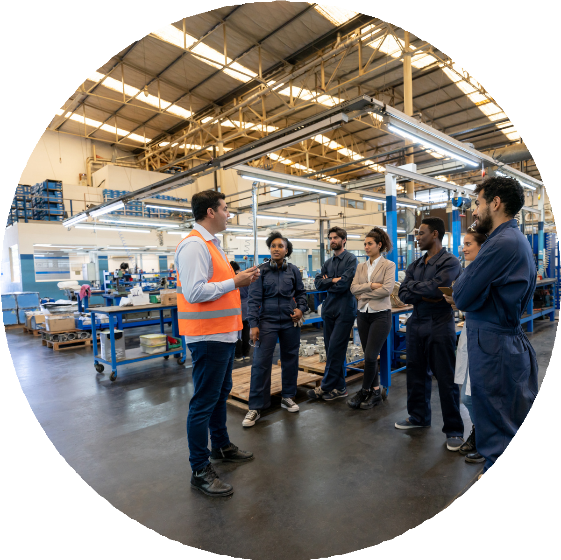
Shinrai Equipment Clinic
Shinrai Equipment clinic is a service arm of TMI ( Shinrai in Japanese means Trust ) focussing on enhancing Longevity of Investment of our valued customers, helping achieve higher availability of equipment targeting optimisation/utilisation of Equipment.
Our qualified and trained service team is fully equipped to support in maintaining high uptime and productivity of the equipment.
We have plan to setup multiple workshops spread across India to ease logistic challenges to extend support to your equipment nearest to the point of use.

Slide 14
Shinrai Equipment Clinic
Shinrai Equipment clinic provides Services like:
Onsite service with AMC Contracts
Machine refurbishment at Equipment clinic
Preventive Maintenance of Equipment.
Keeping Inventory of critical spares parts
Add on Services towards Optimisation & Higher Productivity
Digital Monitoring of health of machines.
Management Advisory for productivity and cost efficiency improvements for Customer’s Project/Site
Skill Mapping Consultancy
Trained Equipment driver availability

Slide 15

Leadership
Profile

Slide 16
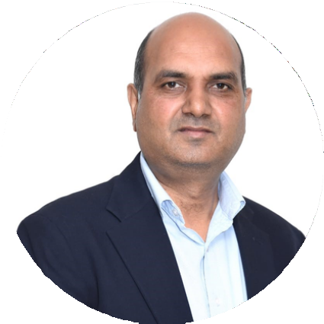
Mukesh has three decades of experience in Auto OEMS like M&M, Hero MotoCorp, Case New Holland & PTL - Top companies in their respective business segments.
Handled multiple large operations with turnover of over Rs 10K crore. Mastered the art of establishing new manufacturing setups, Turnaround the existing operations/ supply chain. Established World class practices using Lean, Deming and TPM methodology.
Mukesh Goyal - Co Founder & CEO
NIT Kurukshetra alumnus with advance Sr leadership program from Wharton Business school, Philadelphia, USA
16

Slide 17
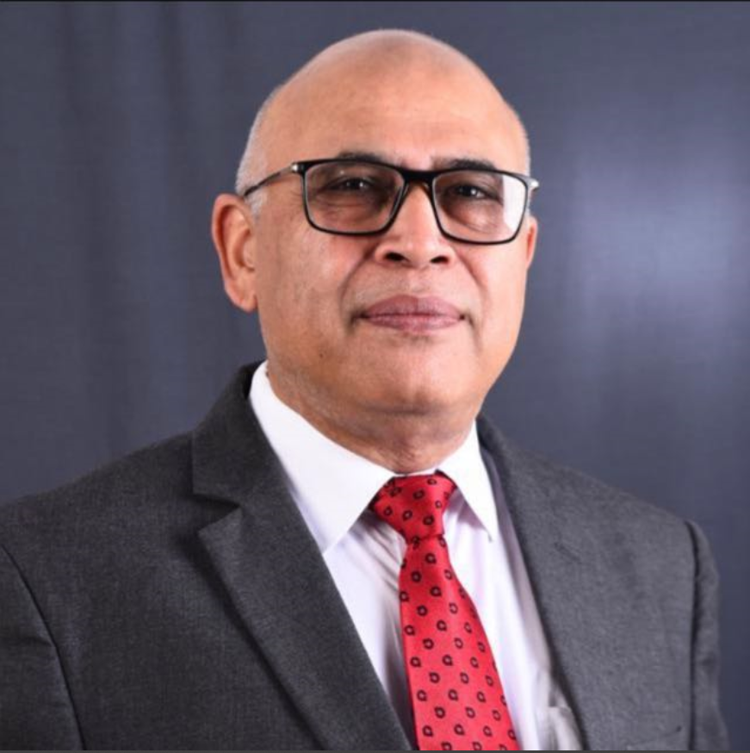
Puneet has over three decades of experience in launching new technologies & products in Construction/Mining/ Equipment Manufacturing industry . Specializing in directing Sales & Service teams field and help desk support system. Having worked directly and indirectly under various capacities for brands like ESCORTS, IR, ATLAS COPCO, PUTZMIESTER, LINTECH, APPOLO INFRATECH, TEREX, FINE, NORMET etc.
Puneet Nurula – COO
17

Slide 18
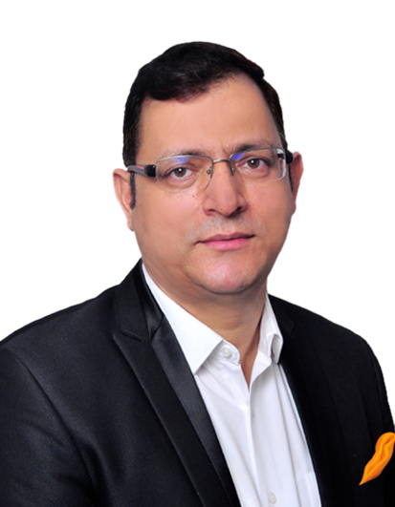
Ajay has more than three decades of experience across the globe in Construction domain initially in Infrastructure projects followed by Multinational & domestic companies supplying variety of construction materials like Cement, RMC, Flyash, Slag, GGBS, AAC, Tile adhesive, Microsilica, Ultrafine slag etc. Amongst few profiles he handled are - Director Marketing APAC - Holcim Singapore, COO – Alccofine, JV Company of Ambuja Cement, Unit Head -Cement Plant – Ambuja Cement, CEO – Ultrafine Minerals & Admixtures Private ltd, CEO – Ashtech India Private Ltd MFP division, Regional Sales & Marketing and Technical Services Head Ambuja Cement
Ajay Pathik - Business Head
SPJIMR Mumbai, IMT Ghaziabad & Vikram University Ujjain aluminous with senior leadership management program from St Gallen University Switzerland, Duke Corporate Education London UK, IIM Kolkatta & ISB Mohali
18

Slide 19


19

Slide 20
Why Us
TMI Engineering believes in India growth story and see a bright future for infrastructure & Mining sectors. Our Leadership team, having more than three decades of experience in relevant industry and are well versed with the challenges faced everyday & understand needs of these sectors.
We believe in building trust with our customers and committed to provide them world class service. Our highly skilled service personnel in the field are determined to ensure optimal machine performance and deliver an inclusive, seamless, and transparent customer experience
We’re Committed to creating an environmentally conscious organization which can help our customers increase safety, sustainability, and productivity throughout the lifecycle of their projects.

Slide 21

Contact Us
TMI Engineering Pvt Ltd
+919821878917
+919818842787
+919997123333
@
info@tmieng.com

Slide 22
Thank You

